Slide 1
THE COUNTER Platform field for Cost Usage
Yoel Kortick
Senior Librarian

Slide 2
Background – Why do we need this field?
Field "COUNTER platform" in collection and portfolio editor – high level
A real example using the COUNTER platform
Field "COUNTER platform" in collection and portfolio editor – additional info

Slide 3
Background – Why do we need this field?

Slide 4
Background – Why do we need this field?
There are often cases where one electronic resource is loaded to Alma via multiple COUNTER platforms.
The resource then appears in Alma Analytics "Usage Data" subject area and the "Cost Usage" of the "E-Inventory" subject area (correctly) with multiple platforms.
However, the institutions often want to calculate the "Cost Usage" for one particular platform, even though it was loaded in COUNTER reports of different platforms.
We will now look at an example.

Slide 5
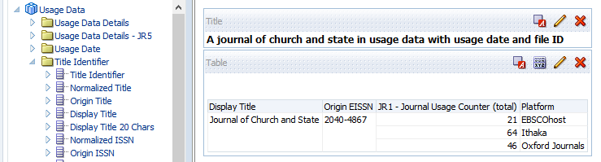
Background - Why do we need this field?
Here in the Usage Data subject area we see that title "A Journal of Church and State" identifier 2040-4867 has three platforms: EBSCOhost, Ithaka, Oxford Journals

Slide 6
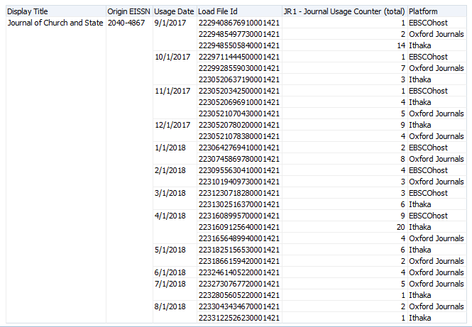
Background - Why do we need this field?
Now we add the usage date and load file ID.
For usage date between 2017-08-31 and 2018-08-30 COUNTER reports were loaded for this title from three different platforms for the same periods.

Slide 7
Background - Why do we need this field?
The next slide shows three different COUNTER reports which were loaded to Alma. All three are for the same:
  Usage dates: Usage between 2017-11-01 and 2017-11-30
  Identifier: 2040-4867
  Title: Journal of Church and State
But they each have a different platform:
  The one on the left is for platform EBSCOhost
  The one in the middle is for platform Ithaka
  The one on the right is for platform Oxford Journals

Slide 8
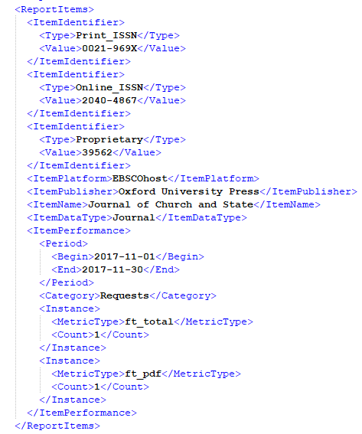
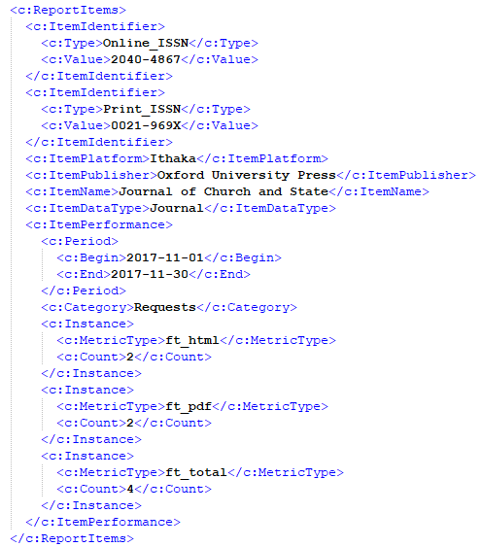
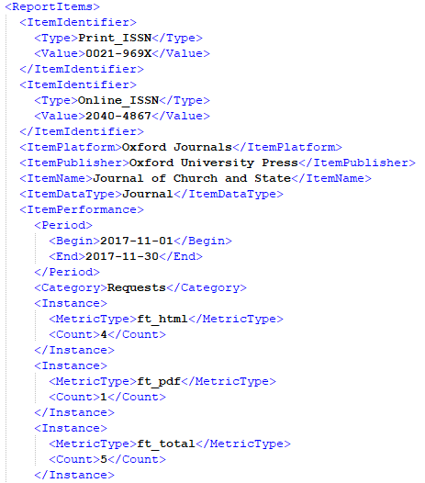
Background - Why do we need this field?

Slide 9
Background - Why do we need this field?
How is Alma supposed to know which platform to use for Cost Usage?
There is usage for same dates, same title, and same identifier for different platforms The example here has three different platforms.
Alma will know which platform to use for the Cost Usage by consulting the COUNTER platform field in the Alma user interface.

Slide 10
Field "COUNTER platform" in collection and portfolio editor – high level

Slide 11
"COUNTER platform" in collection and portfolio editor – high level
A new field has been added to the electronic collection editor and the electronic portfolio editor of the Alma user interface.
It is called "COUNTER Platform".
It effects the Cost Usage calculations in the E-Inventory subject area.
If it is not filled in then everything behaves as it did before this field was created.
If it is filled in then the platform with which it is filled in is used for the calculation of the Cost Usage in the E-Inventory subject area.

Slide 12
"COUNTER platform" in collection and portfolio editor – high level
Thus for the example here the institution can use the field "COUNTER platform" to attribute title "A Journal of Church and State" identifier 2040-4867 to one of the following platforms:
  EBSCOhost
  Ithaka
  Oxford Journals

Slide 13
A real example using the COUNTER platform

Slide 14


A real example using the COUNTER platform
We have not yet filled in the COUNTER Platform field in the Alma user interface.
Here is title we have been looking at, "A Journal of Church and state", in a cost usage report in the E-Inventory subject area.
All three COUNTER platforms appear.

Slide 15
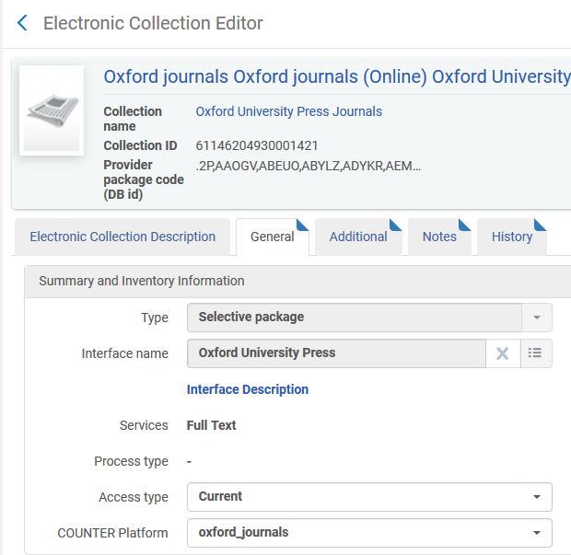
A real example using the COUNTER platform
Now we fill in the COUNTER platform for electronic collection "Oxford University Press Journals" and choose platform "Oxford Journals".
This is the electronic collection which contains portfolio "A Journal of Church and State"

Slide 16
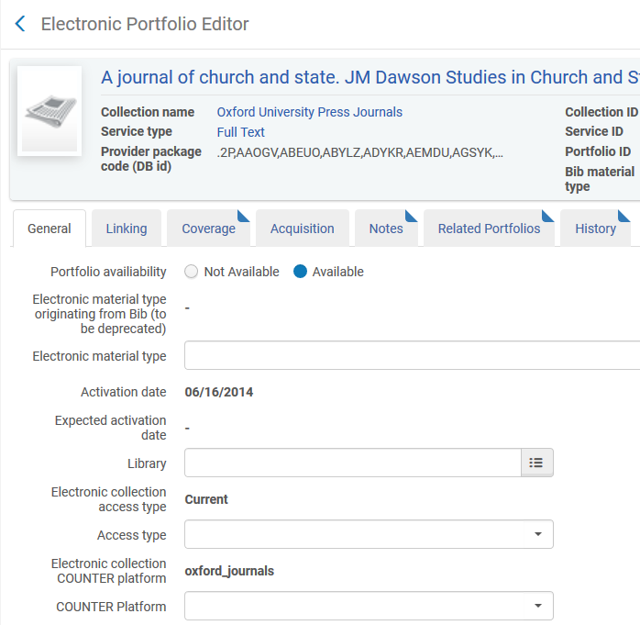
A real example using the COUNTER platform
All portfolios of electronic collection "Oxford University Press Journals" inherit COUNTER platform "Oxford Journals" unless otherwise specified (overwrite)
Portfolio "A Journal of Church and State"
The COUNTER platform from the collection could be overwritten here

Slide 17
A real example using the COUNTER platform
Now if we look at the Cost Usage report we see that Portfolio "A Journal of Church and State" no longer has all three platforms.
It has only platform "Oxford Journals" because that is the platform chosen in the Alma user interface for COUNTER platform.

Slide 18
A real example using the COUNTER platform
Before
After
Cost is the total cost, which "Before" was divided amongst the three platforms
Usage is usage for only platform "Oxford Journals"

Slide 19
A real example using the COUNTER platform
Note that in the Usage Data subject area all three platforms still appear.
The change has occurred only for "Cost Usage" in the E-Inventory subject area.

Slide 20
A real example using the COUNTER platform
We have successfully used the "COUNTER Platform" in Alma to determine which specific platform should be used for the purpose of Cost Per use in Alma Analytics.
The title "A Journal of Church and State" has three platforms because three platforms were loaded in COUNTER reports for the title.
The institution wants to use only platform "Oxford Journals" for the purpose of cost per use.
The institution filled in the COUNTER platform in Alma as "Oxford Journals" and now the Analytics Cost Per use uses only platform "Oxford Journals".

Slide 21
Field "COUNTER platform" in collection and portfolio editor – additional info

Slide 22
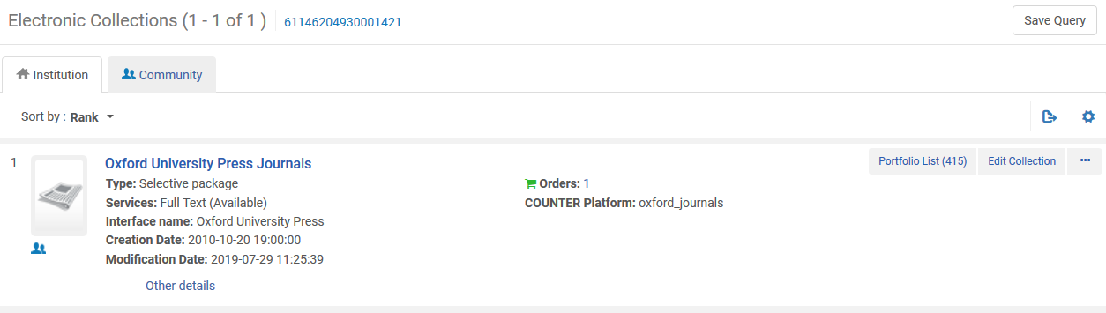
Field "COUNTER platform" in collection and portfolio editor – additional info
The field COUNTER Platform appears not only in the electronic collection editor and electronic portfolio editor but also in the repository search results. Here is electronic collection repository search results.

Slide 23
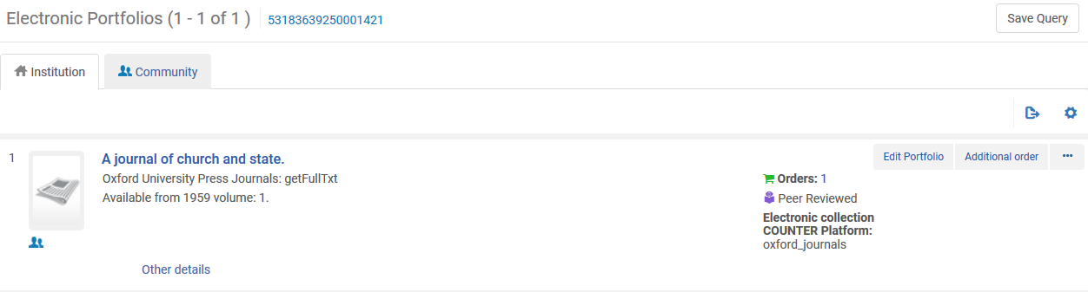
Field "COUNTER platform" in collection and portfolio editor – additional info
Here is electronic portfolio repository search results.

Slide 24
Field "COUNTER platform" in collection and portfolio editor – additional info
It is also possible to search by the COUNTER platform, provided that it is activated at Configuration > Resources > Search Indexes.
Here the following have both been activated for Advanced Search.
  iepa_counterPlatform (for electronic collection COUNTER Platform)
  portfolio_counterPlatform (for Portfolio COUNTER Platform)

Slide 25
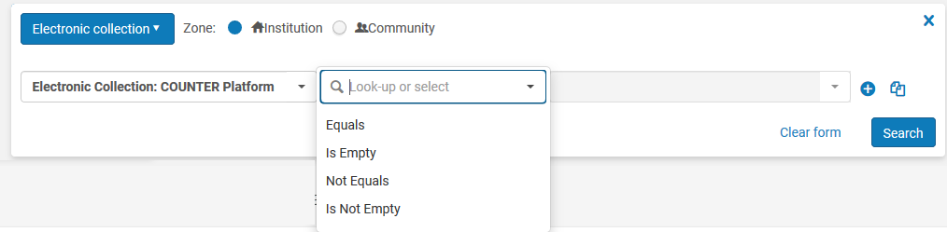
Field "COUNTER platform" in collection and portfolio editor – additional info
Here is the COUNTER platform for Electronic Collection advanced search

Slide 26
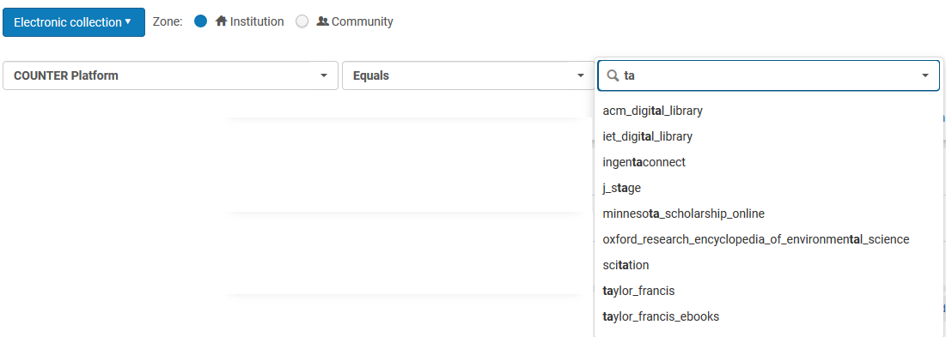
Field "COUNTER platform" in collection and portfolio editor – additional info
When choosing a value to search the user can start typing and an auto complete options brings the remainder of the normalized platform
All platform names which include "ta"

Slide 27
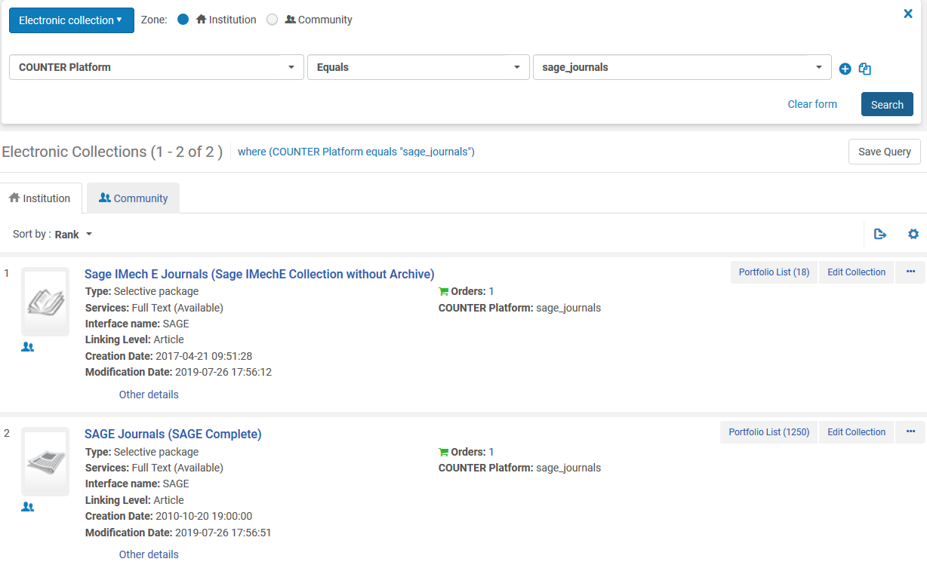
Field "COUNTER platform" in collection and portfolio editor – additional info
Here are Electronic Collections with COUNTER Platform Sage Journals

Slide 28

Field "COUNTER platform" in collection and portfolio editor – additional info
When the COUNTER Platform is entered into a field, either for search or when adding a value in the electronic resource editor, the normalized platform value is used.
This is in order to "Combine" the same values which have been added slightly differently via COUNTER reports.
For example here we see that platform HighWire Press has been loaded in COUNTER reports as both
Highwire Press
and
HighWire Press
Here we are looking in the Usage Data subject area

Slide 29
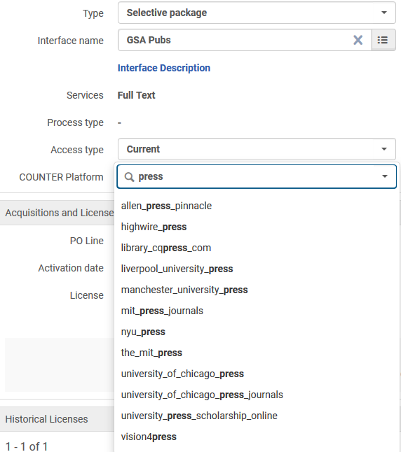
Field "COUNTER platform" in collection and portfolio editor – additional info
When adding the COUNTER Platform we add normalized value highwire_press and that will include both non-normalized values "Highwire Press" and "HighWire Press".

Slide 30

Field "COUNTER platform" in collection and portfolio editor – additional info
Regarding Alma Analytics:
In the "Cost Usage Details" folder of the "Cost Usage" section of the E-Inventory subject area COUNTER platform defined in the Alma user Interface and the COUNTER Platform from the COUNTER reports both appear.
Platform (from COUNTER report): The platform as it appears in the COUNTER report which was loaded to Alma with no changes
COUNTER Platform (defined in E-Resource of UI Alma): The COUNTER platform as added in the field COUNTER Platform of the Electronic Resource in the Alma UI.

Slide 31
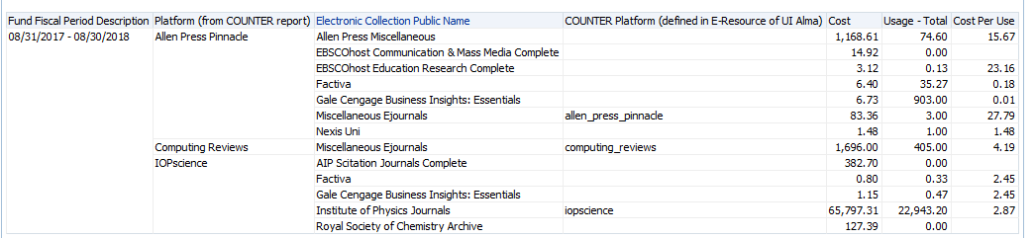
Field "COUNTER platform" in collection and portfolio editor – additional info
Regarding Alma Analytics:

Slide 32
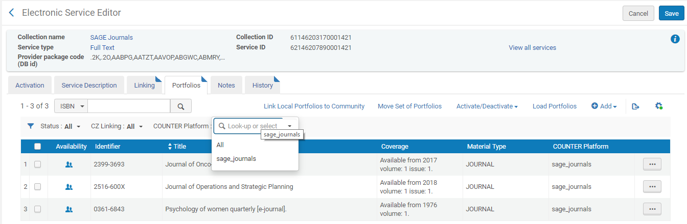
Field "COUNTER platform" in collection and portfolio editor – additional info
The field "COUNTER Platform" also appears in the "portfolios" tab of the "electronic service editor".
It is possible to filter by the "COUNTER Platform" and the "COUNTER platform" has been added as a new column

Slide 33
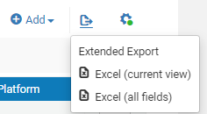

Field "COUNTER platform" in collection and portfolio editor – additional info
The export to "Extended Report" includes the "COUNTER Platform"

Slide 34
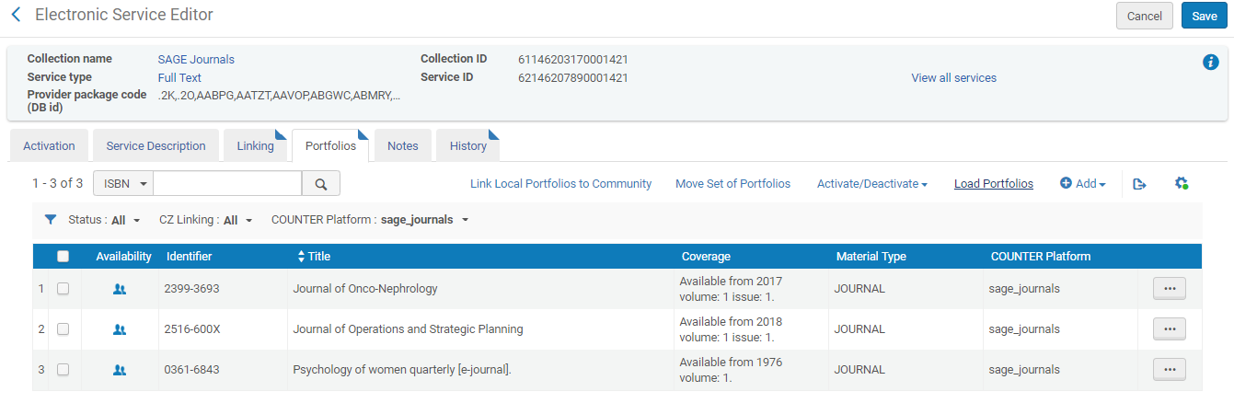
Field "COUNTER platform" in collection and portfolio editor – additional info
This "COUNTER Platform" in the Excel sheet is also taken into account when loading portfolios via an Excel sheet .

Slide 35
Yoel

